Slide 1
Weekly hw

Slide 2
Hw policy
HW is not collected nor graded
Hw is a “survival” tool
Monthly papers which are due
Papers on average ~= 10 pages
Graphs, illustration, visuals
Bib
Hw helps you nip away at the big project

Slide 3
Paper one
What sources of stress do college kids suffer from?
How do they cope
What does the leading research say?
What tools can we generate to help us discern new knowledge?
Where does knowledge end, and where can we generate new knowledge, based upon the design of a tool?

Slide 4
hw
Create two documents:
Paper
Summary of sources

Slide 5
Summary of sources
Whenever you read a scholarly document, summarise the contents of it in one-two paragraphs
4 sentences tops
2 sentences is better

Slide 6
Saving
Every sentence

Slide 7
paper
Create the bibliography for it
bib

Slide 8
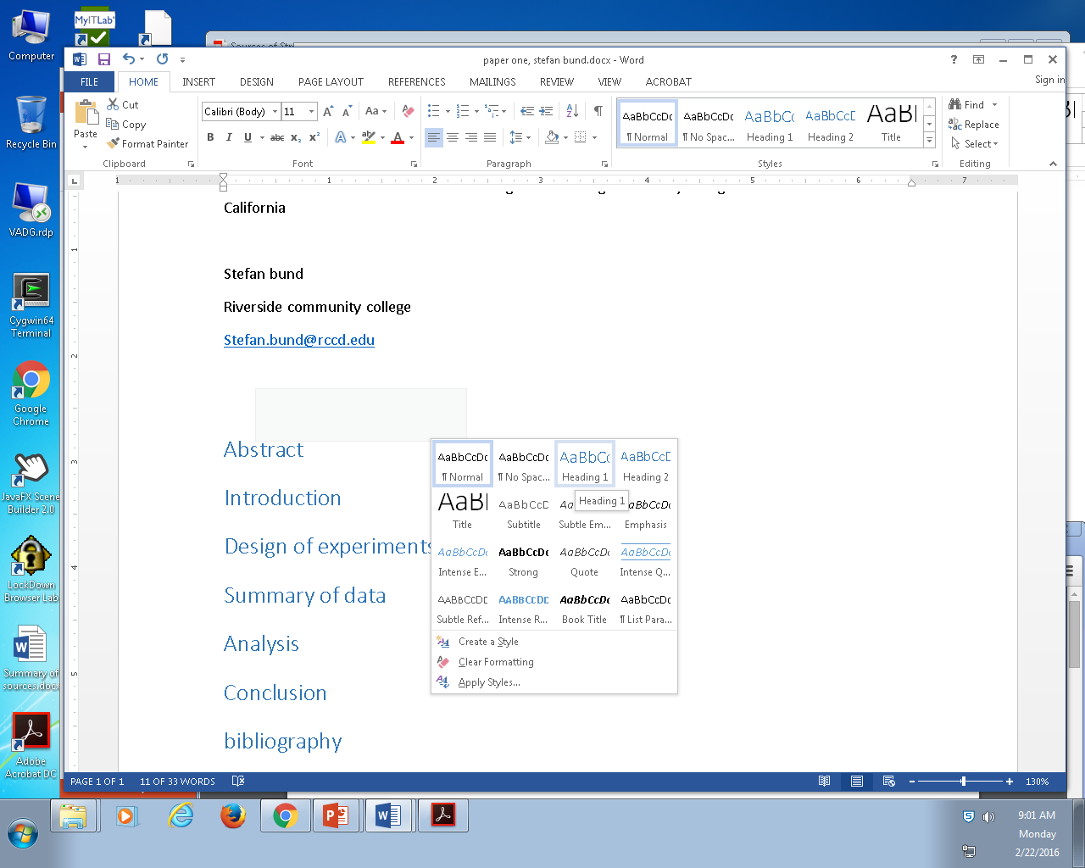

Slide 9
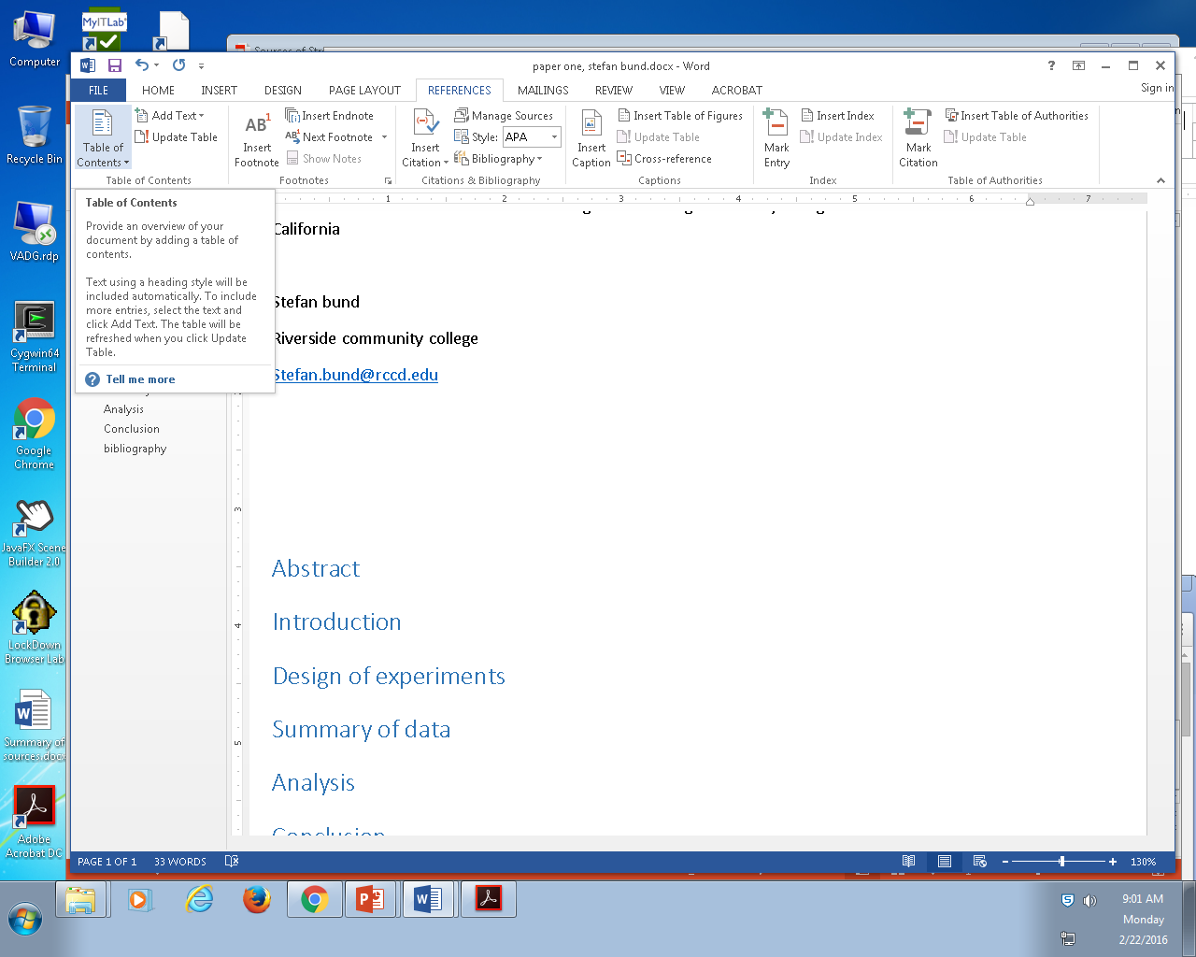

Slide 10
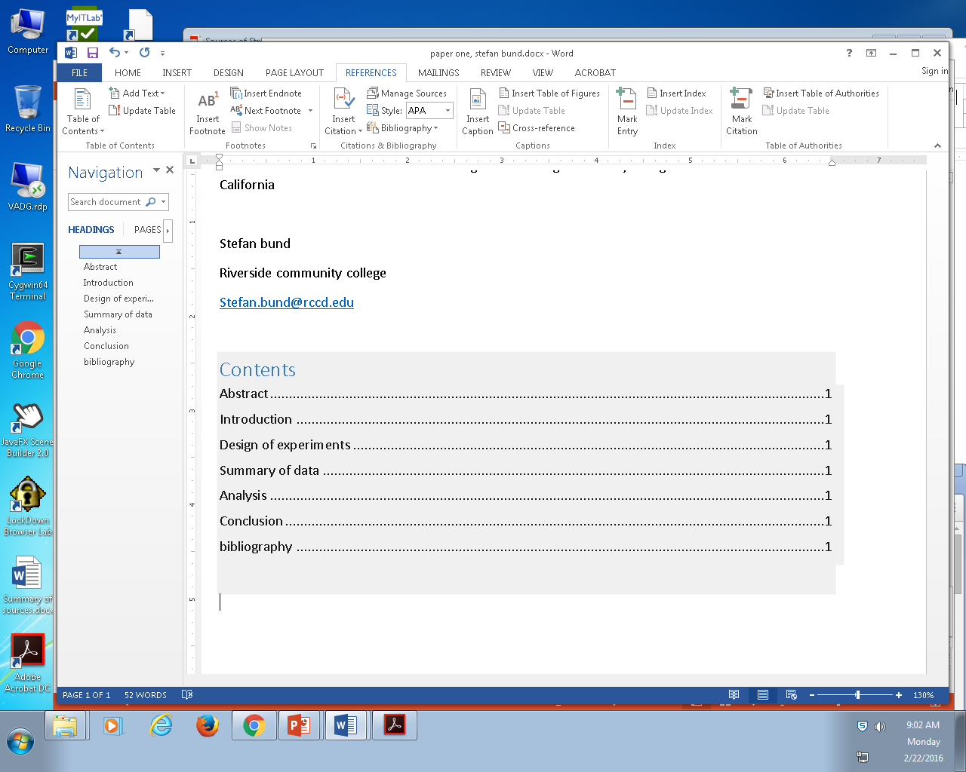

Slide 11
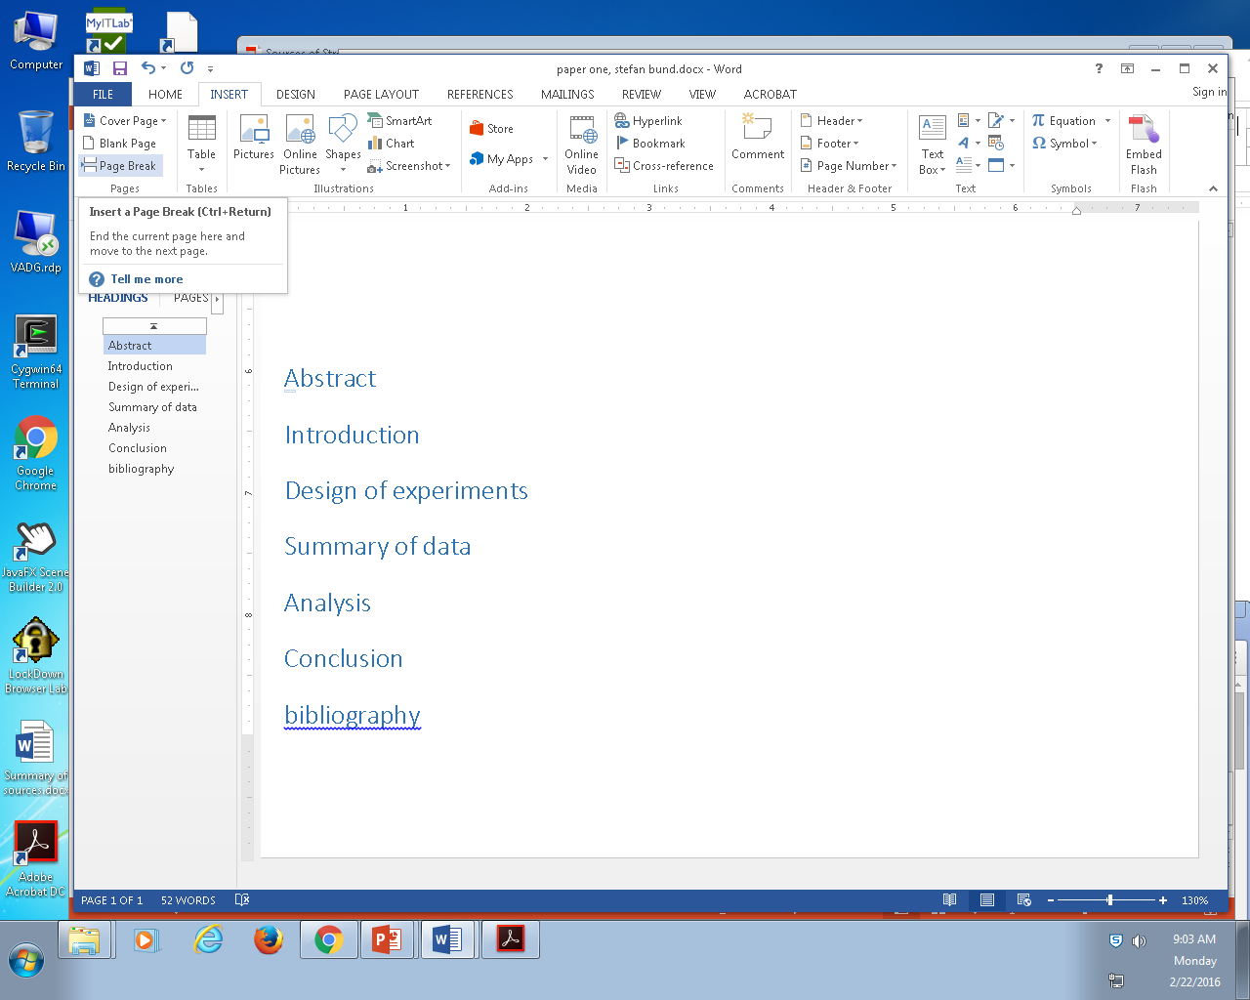

Slide 12
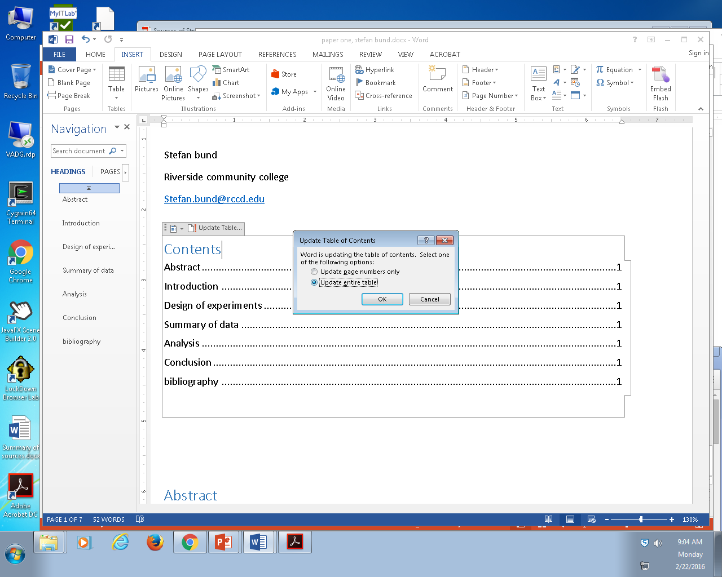

Slide 13
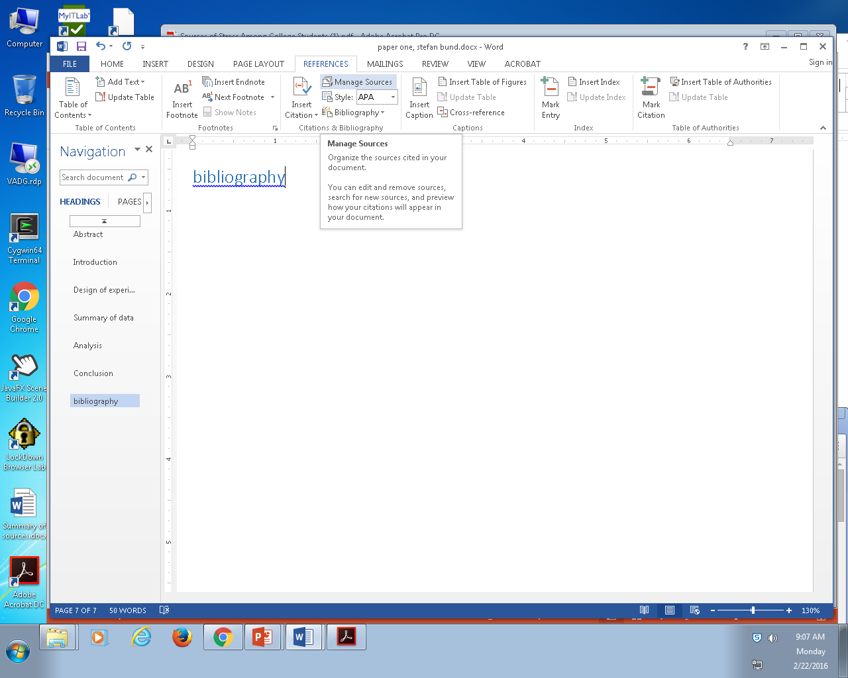

Slide 14
